Slide 1
—Key Battles— The Civil War (1861-1865)
The American Pageant,
Chapters 20-21

Slide 2
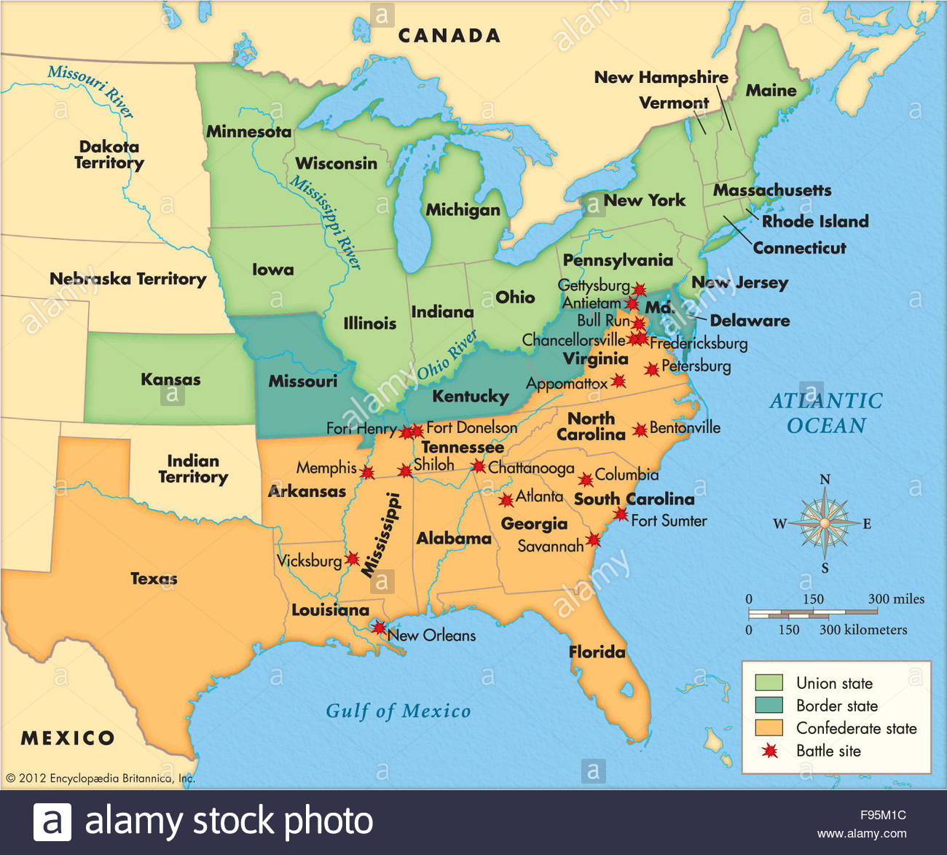
Deadliest War in U.S. History—over 600,000 Deaths

Slide 3
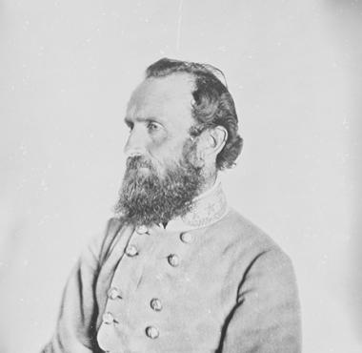
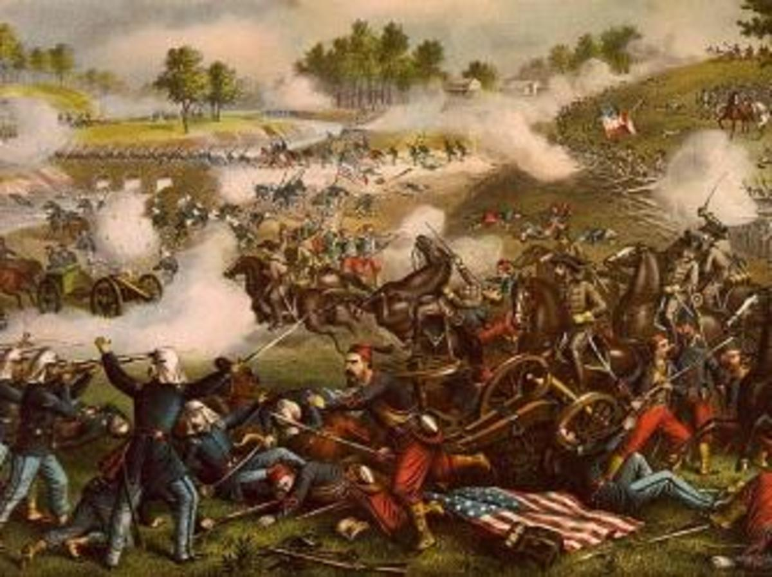
Battle of Bull Run
Victory for the South
Thought to be a 90-day war
Bull Run proves otherwise
Victory for the South
Early on—South has more victories than the North

Slide 4
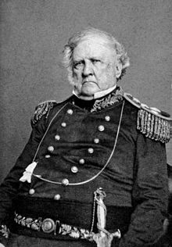
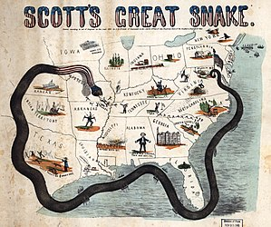
The Anaconda Plan
Anaconda Plan
Winfield Scot
Blockade the Confederacy
Control ports and Mississippi River

Slide 5
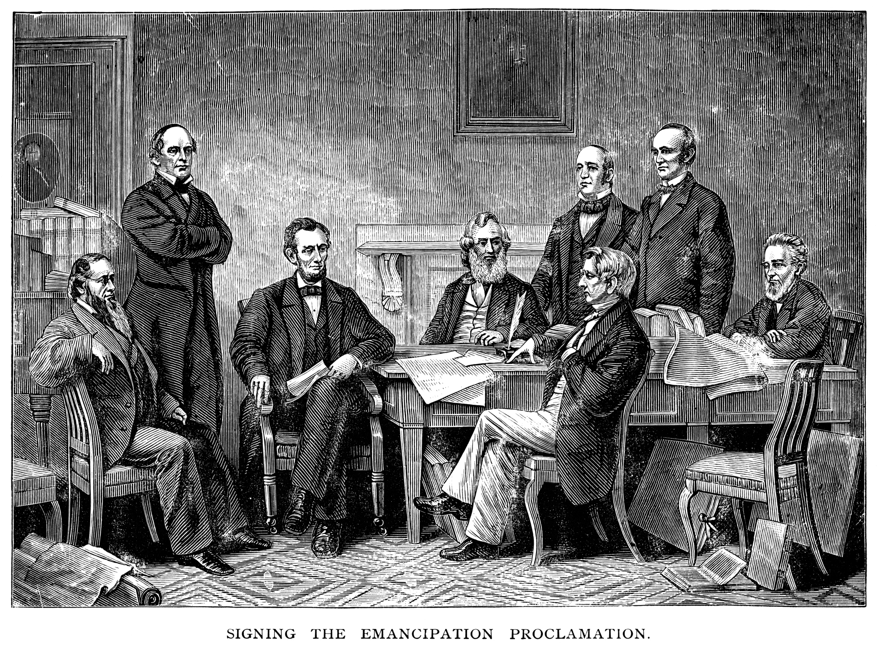
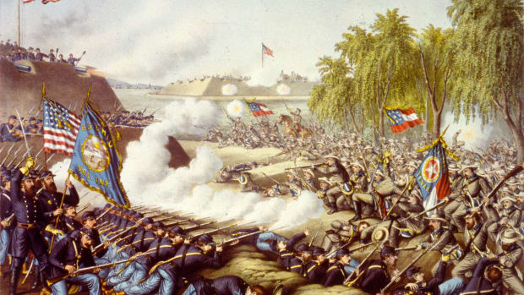
Battle of Antietam
Lee goes to Maryland
Border State
Receive foreign recognition for South
Ends up not happening
Draw more states over to Confederacy
Battle is technically a draw
Lee retreats
Lincoln issues Emancipation Proclamation (effective January 1863)

Slide 6
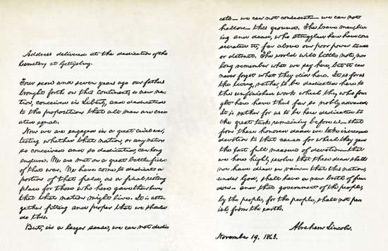
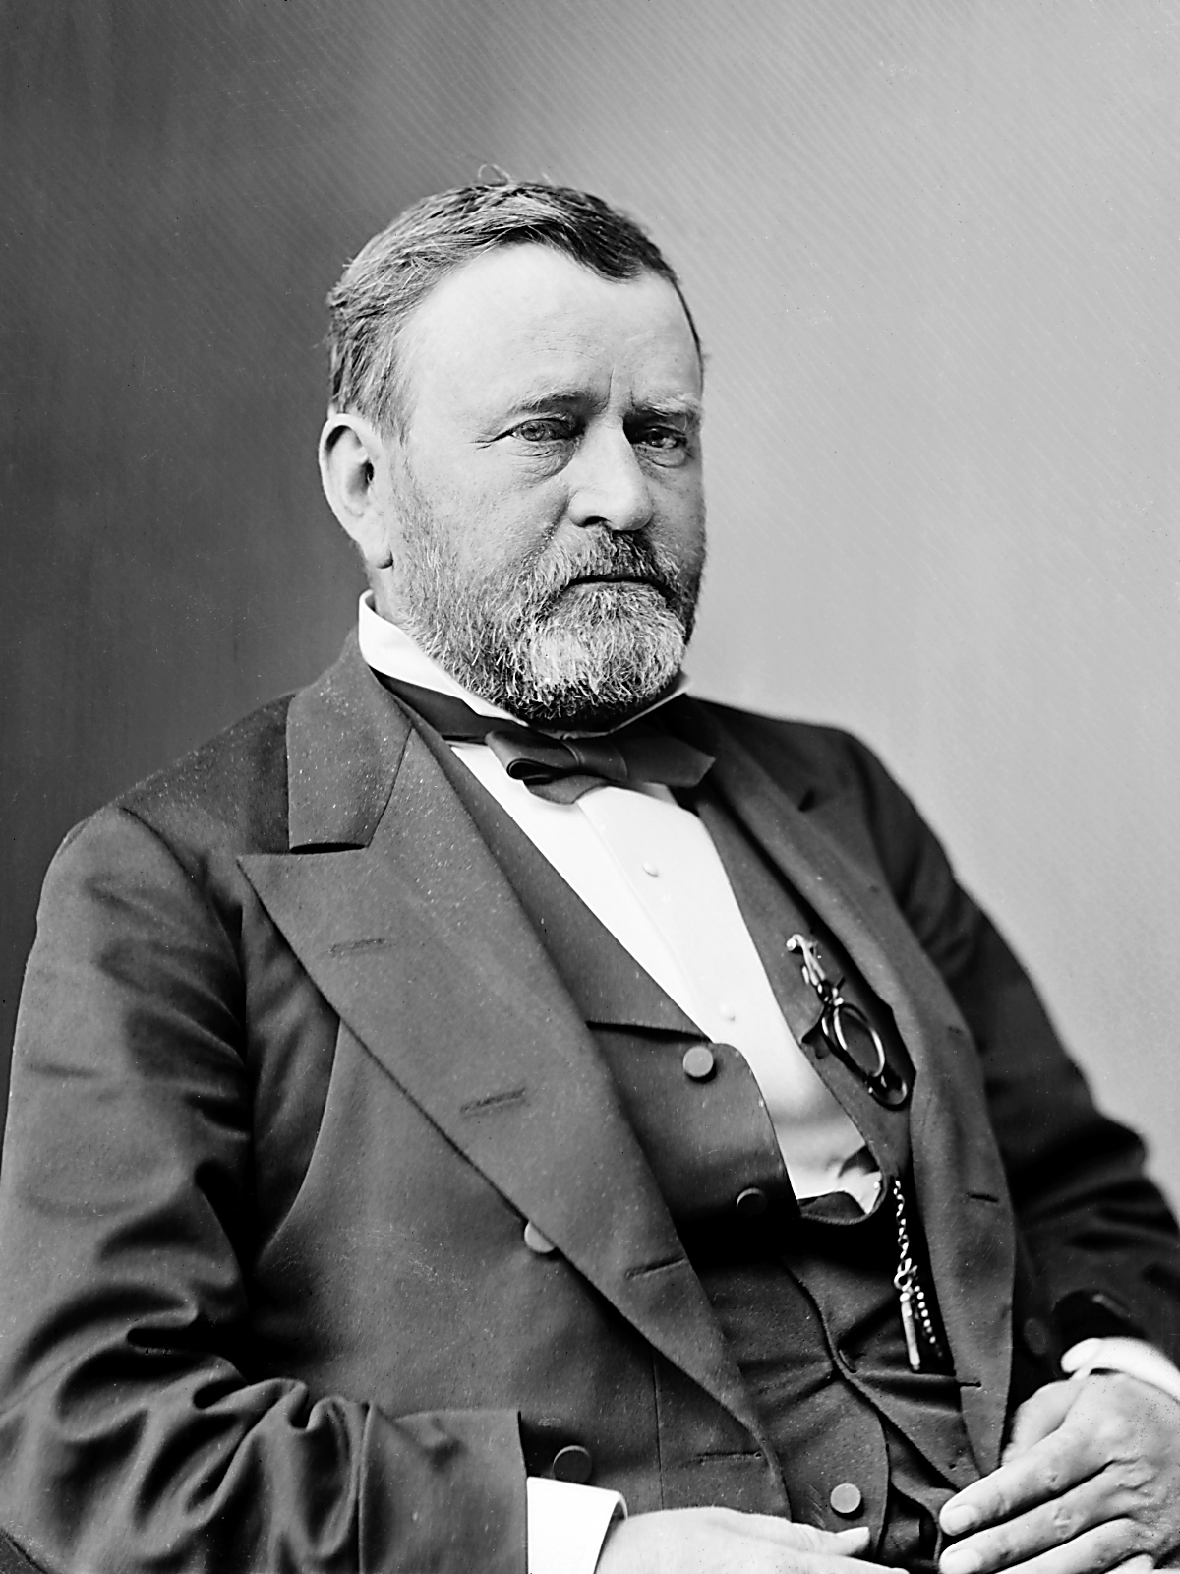
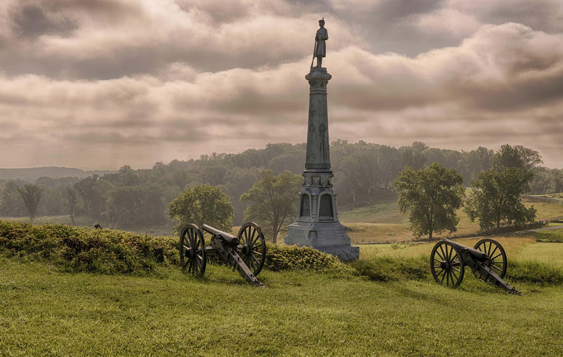
Ulysses S. Grant
Military leader for the Union
Victories in the west
Tennessee
Vicksburg (July 4, 1863)
Actually two defeats for the South
Gettysburg: Lee invades Pennsylvania; hoping for victory; forced to retreat
Vicksburg: North gains control of the Mississippi River

Slide 7
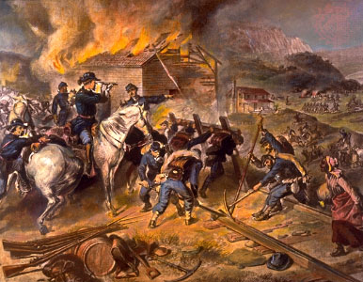
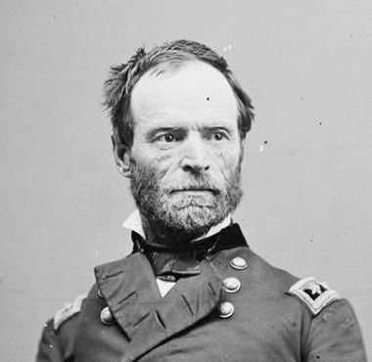
William Tecumseh Sherman
Union General
Use of total war in the South
Destroy everything
Takes Atlanta in 1864
Helps Lincoln achieve re-election

Slide 8
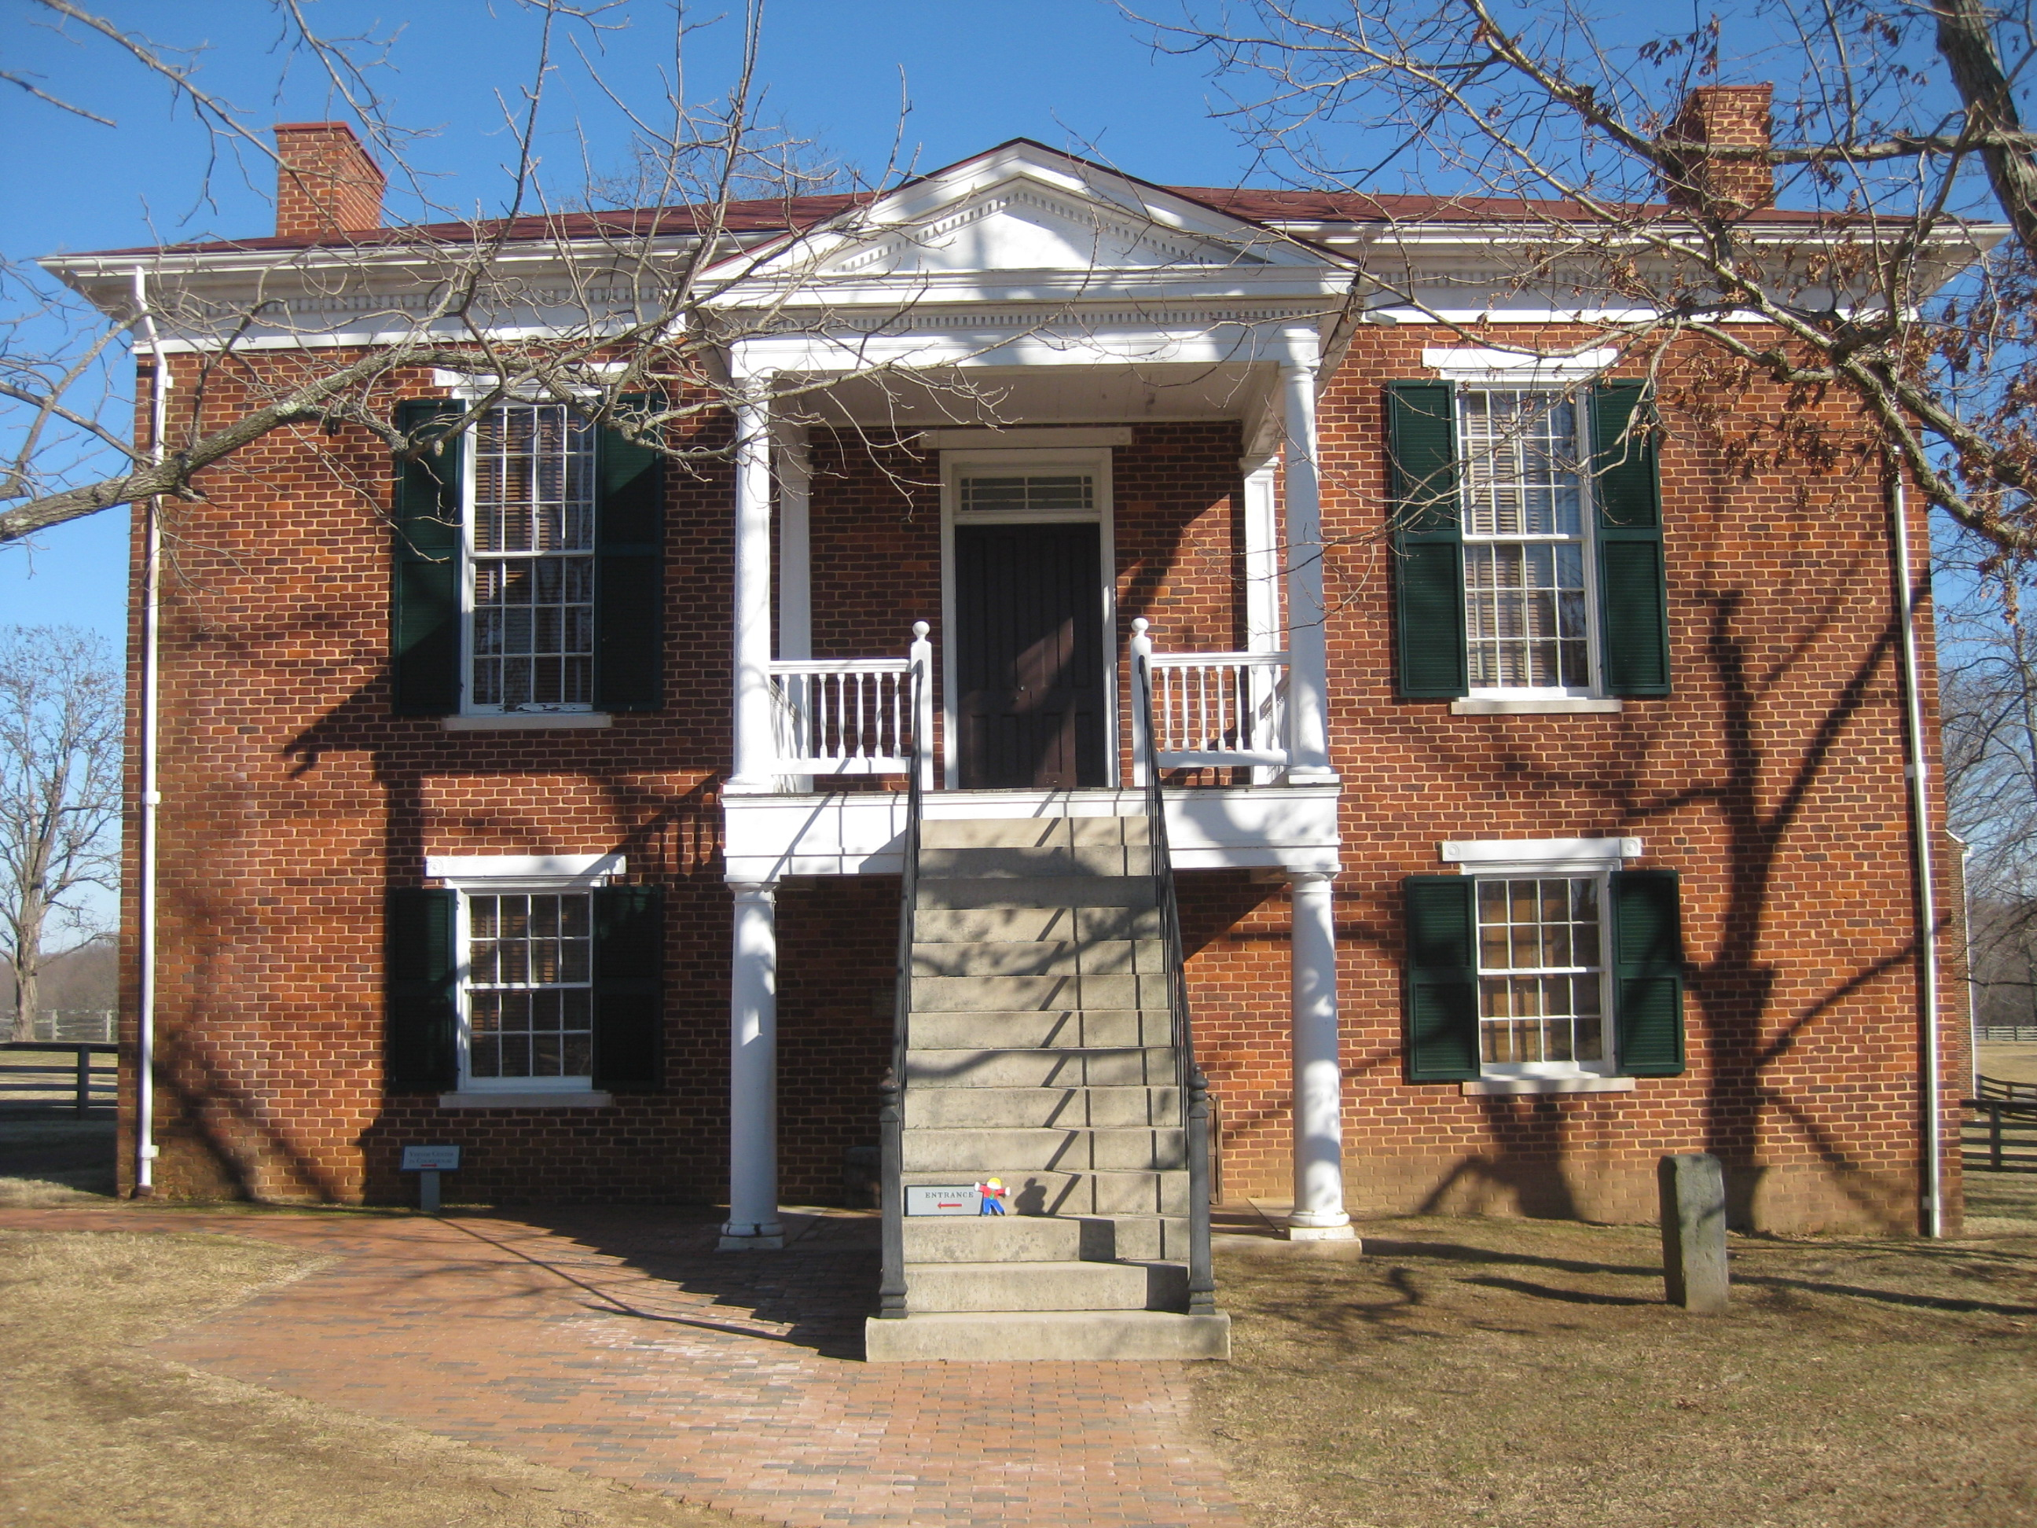
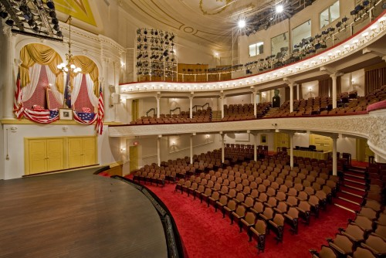
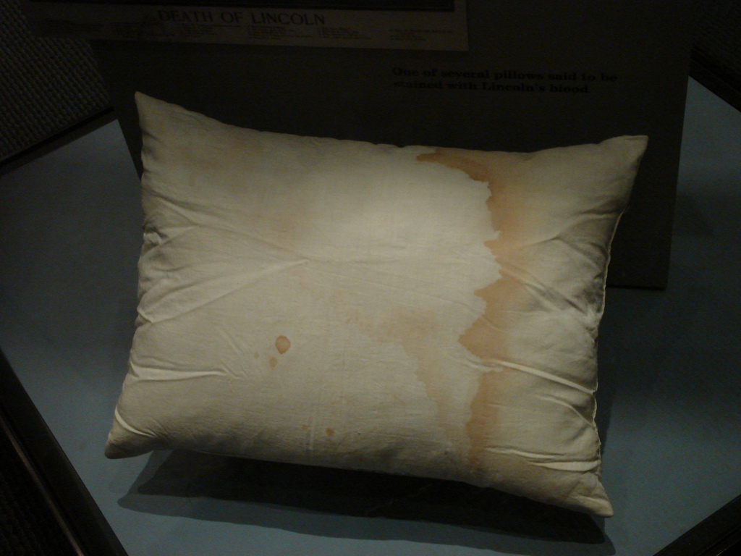
The War’s End
April 9, 1865
Lee surrenders at Appomattox Court House in Virginia
Lincoln assassinated the following week
Good Friday—April 14, 1865

